Slide 1
Design, Implementation and Management of Database Systems
Schema Refinement and Normal Forms
Dr. Xiao Yan
School of Computer Science
yanxiaosunny@whu.edu.cn

Slide 2
Motivation Example
Id | name | age | rating | Hourly_wages | Hours_worked
123-22-3666 | Peter | 48 | 8 | 10 | 40
231-31-5368 | Paul | 22 | 8 | 10 | 30
131-24-3650 | Mary | 35 | 5 | 7 | 30
434-26-3751 | David | 35 | 5 | 7 | 32
612-67-4134 | Ada | 35 | 8 | 10 | 40
Observe these two columns
The values of hourly_wages depend on that of rating.
  Rating = 8 ➔ hourly_wages = 10
  Rating = 5 ➔ hourly_wages = 7

Slide 3
Motivation Example
Id | name | age | rating | Hourly_wages | Hours_worked
123-22-3666 | Peter | 48 | 8 | 10 | 40
231-31-5368 | Paul | 22 | 8 | 10 | 30
131-24-3650 | Mary | 35 | 5 | 7 | 30
434-26-3751 | David | 35 | 5 | 7 | 32
612-67-4134 | Ada | 35 | 8 | 10 | 40
Redundant Storage
  The rating value 8 corresponds to the hourly wage 10, and this association is repeated three times.
  Storage is not used efficiently.

Slide 4
Motivation Example
Id | name | age | rating | Hourly_wages | Hours_worked
123-22-3666 | Peter | 48 | 8 | 10 | 40
231-31-5368 | Paul | 22 | 8 | 10 | 30
131-24-3650 | Mary | 35 | 5 | 7 | 30
434-26-3751 | David | 35 | 5 | 7 | 32
612-67-4134 | Ada | 35 | 8 | 10 | 40
Update Anomalies
  The hourly_wages in the first tuple could be updated without making a similar change in the second tuple.
  Therefore, updates may cause inconsistency.

Slide 5
Motivation Example
Id | name | age | rating | Hourly_wages | Hours_worked
123-22-3666 | Peter | 48 | 8 | 10 | 40
231-31-5368 | Paul | 22 | 8 | 10 | 30
131-24-3650 | Mary | 35 | 5 | 7 | 30
434-26-3751 | David | 35 | 5 | 7 | 32
612-67-4134 | Ada | 35 | 8 | 10 | 40
Insertion Anomalies
  We cannot insert a tuple for an employee unless we know the hourly wage for the employee’s rating value.
  Otherwise, null values may appear in the table.

Slide 6
Motivation Example
Id | name | age | rating | Hourly_wages | Hours_worked
123-22-3666 | Peter | 48 | 8 | 10 | 40
231-31-5368 | Paul | 22 | 8 | 10 | 30
131-24-3650 | Mary | 35 | 5 | 7 | 30
434-26-3751 | David | 35 | 5 | 7 | 32
612-67-4134 | Ada | 35 | 8 | 10 | 40
Deletion Anomalies
  If we delete all tuples with a given rating value (e.g. tuples of Mary and David) we lose the association between the rating value and its hourly_wage value.

Slide 7
Problems caused by redundancy
Redundant Storage
  Some information is stored repeatedly.
Update Anomalies
  If one copy of such repeated data is updated, an inconsistency is created, unless all copies are similarly updated.
Insertion anomalies
  It may not be possible to store certain information unless some other, unrelated, information is stored.
Deletion Anomalies
  It may not be possible to delete certain information without losing some other, unrelated, information.

Slide 8
Decompositions
Intuitively, redundancy arise when a relational schema forces an association between attributes that is not natural.
Functional dependencies can be used to identify such situations and suggest refinements to the schema.
The essential idea is that many problems arising from redundancy can be addressed by replacing a relation with a collection of ‘smaller’ relation.

Slide 9
Id | name | age | rating | Hourly_wages | Hours_worked
123-22-3666 | Peter | 48 | 8 | 10 | 40
231-31-5368 | Paul | 22 | 8 | 10 | 30
131-24-3650 | Mary | 35 | 5 | 7 | 30
434-26-3751 | David | 35 | 5 | 7 | 32
612-67-4134 | Ada | 35 | 8 | 10 | 40
Id | name | age | rating | Hours_worked
123-22-3666 | Peter | 48 | 8 | 40
231-31-5368 | Paul | 22 | 8 | 30
131-24-3650 | Mary | 35 | 5 | 30
434-26-3751 | David | 35 | 5 | 32
612-67-4134 | Ada | 35 | 8 | 40
rating | Hourly_wages
8 | 10
5 | 7
Functional dependency:
- rating determines Hourly_wages
A decomposition of a relation schema R consists of replacing
the relation schema by two (or more) relation schemas that each
contains a subset of attributes of R and together include all
attributes in R

Slide 10
Functional Dependencies
A functional dependency (FD) is a kind of IC that generalizes the concept of a key.
An FD X→ Y essentially says that if two tuples agree on the values in attributes X, they must also agree on the values in attributes Y.
Let R be a relation schema and let X and Y be nonempty
sets of attributes in R.
We say that an instance r of R satisfies the FD X→ Y
If the following holds for every pair of tuples t1 and t2
in r
If t1.X = t2.X, then t1.Y = t2.Y
The notation t1.X refers to the projection of tuple t1 onto the attributes in X

Slide 11
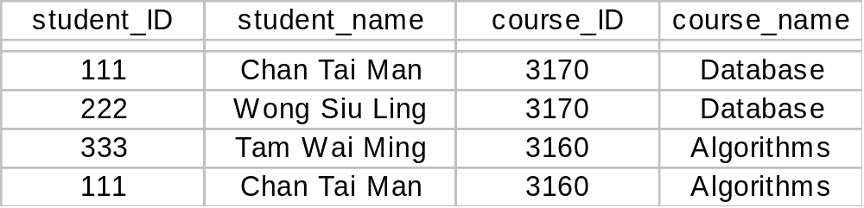
if any two rows never agree on α value, then
→ β is trivially preserved.
e.g. course_ID → course_name is preserved, but not trivially preserved.
e.g. student_ID, course_ID → course_name is trivially preserved, because we cannot find two rows with the same values in student_ID and course_ID.

Slide 12
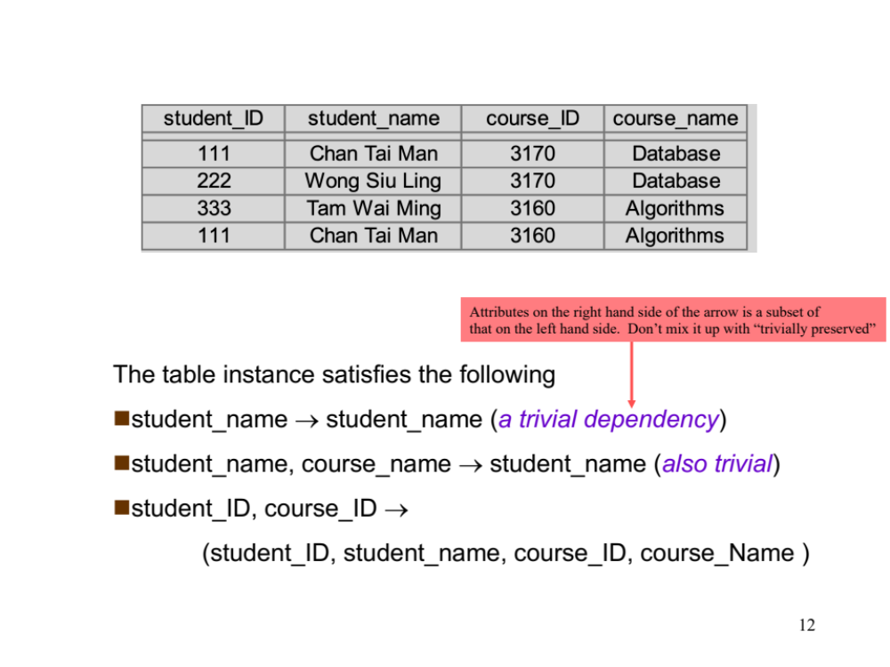
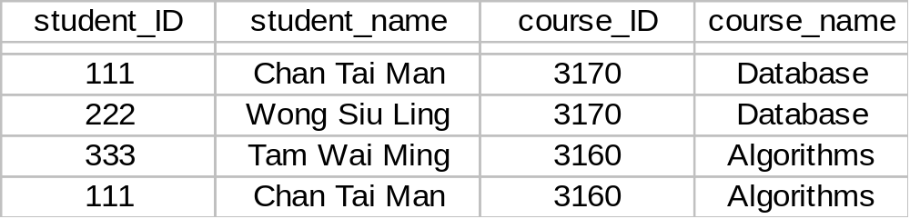
Attributes on the right hand side of the arrow is a subset of
that on the left hand side. Don’t mix it up with “trivially preserved”
The table instance satisfies the following
student_name → student_name (a trivial dependency)
student_name, course_name → student_name (also trivial)
student_ID, course_ID →
(student_ID, student_name, course_ID, course_Name )

Slide 13

α is a superkey for R iff α → R.
where R is taken as the schema for relation R.
α is a candidate key for R iff
  α → R, and
  for no γ that is a proper subset of α, γ → R (minimal property).
(student_ID, course_ID) is a candidate key
(student_ID, course_ID, course_name) is not a candidate key

Slide 14
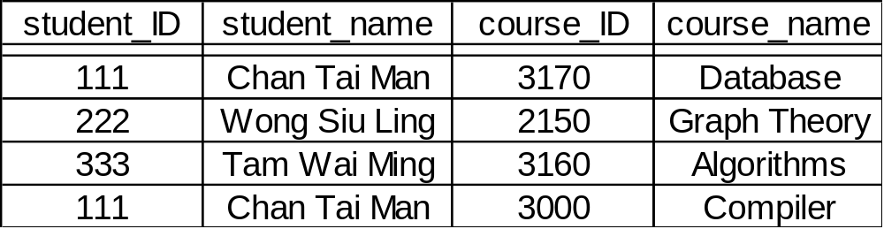
Note:
A functional dependency must be identified based on
semantics of applications, not on individual relation instances.
Given an instance r of R, we can check if r violates some
functional dependency f, but we cannot tell if f holds over R.
course_ID → student_name ?

Slide 15
The semantics of an application is a set of constraints
imposed by the application.
This set of constraints are set up either explicitly or
implicitly.
Explicitly: by domain experts
Implicitly: by ‘common sense’

Slide 16
Example:
Application is to keep track of information about
employees in a company.
Information to be kept track of includes:
eid: employee’s id number
ename: employee name
address: address of the employee
sex: employee’s sex
dname: name of the department that the employee works for
dhname: department head’s name
dhsex: department head’s sex

Slide 17
Let’s construct a relation schema as follows:
Which of the following dependencies are true?
  eid → ename
  ename → eid
  eid → address
  eid → sex
  sex → address
  dhname → dname
  dhname → eid
  dhsex → sex
Employee
eid
ename
address
sex
dname
dhname
dhsex
√
Given
a:Employee’s id number is unique
b:Each employee works for only one dept.
c:Each department has only one head
Implicit: common sense
×
√
√
×
×
×
×

Slide 18
Reasoning about FDs
F – a set of functional dependencies
f – an individual functional dependency
f is implied by F if whenever all functional dependencies in F are true,
then f is true.
For example,
Consider Workers(id, name, office, did, since)
{ id → did,
did → office }
implies:
id → office

Slide 19
Closure of a set of FDs
The set of all FDs implied by a given set F of FDs is called the closure of F, denoted as F ⁺ .
Armstrong’s Axioms, can be applied repeatedly to infer all FDs implied by a set of FDs.
Suppose X,Y, and Z are sets of attributes over a relation.
Armstrong’s Axioms
Reflexivity: if Y ⊆ X, then X → Y (trivial dependency)
Augmentation: if X → Y, then XZ → YZ
Transitivity: if X → Y and Y → Z, then X → Z

Slide 20
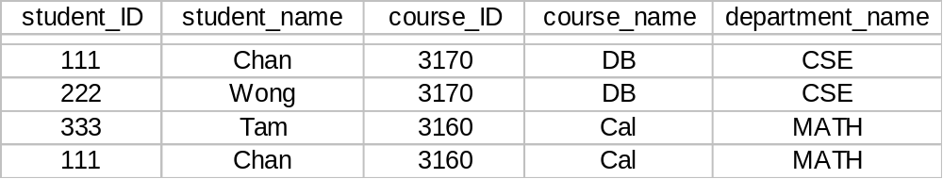
reflexivity:
student_ID, student_name → student_ID
student_ID, student_name → student_name
augmentation:
student_ID → student_name
implies
student_ID, course_name → student_name, course_name
transitivity:
course_ID → course_name and course_name →department_name
Implies course_ID → department_name

Slide 21
Armstrong’s Axioms is sound and complete.
  Sound: they generate only FDs in F⁺.
  Complete: repeated application of these rules will generate all FDs in F⁺.
The proof of soundness is straight forward, but completeness is harder to prove.

Slide 22
Proof of Armstrong’s Axioms (soundness)
Notation: We use t[X] for Π_{X} [ t ] for any tuple t.
Reflexivity: If Y ⊆ X, then X → Y
Assume ∃ t₁, t₂ such that t₁[X] = t₂[X]
then t₁[ Y ] = t₂[ Y ] since Y ⊆ X
Hence X → Y

Slide 23
Augmentation: if X → Y, then XZ → YZ
Assume ∃ t₁, t₂ such that t₁ [ XZ ] = t₂ [ XZ]
t₁ [Z] = t₂ [Z], since Z ⊆ XZ ------ (1)
t₁ [X] = t₂ [X], since X ⊆ XZ
t₁ [Y] = t₂ [Y], definition of X → Y ------ (2)
t₁ [YZ] = t₂ [ YZ ] from (1) and (2)
Hence, XZ → YZ

Slide 24
Transitivity: If X →Y and Y → Z, then X →Z.
Assume ∃ t₁, t₂ such that t₁ [X] = t₂ [X]
Then t₁ [Y] = t₂ [Y], definition of X → Y
Hence, t₁ [Z] = t₂ [Z], definition of Y →Z
Therefore, X →Z

Slide 25
Additional rules
Sometimes, it is convenient to use some additional rules while reasoning about F⁺.
These additional rules are not essential in the sense that their soundness can be proved using Armstrong’s Axioms.
Union: if X → Y and X → Z , then X → YZ.
Decomposition: if X → YZ, then X → Y and X → Z.

Slide 26
To show correctness of the union rule:
X → Y and X → Z , then X → YZ ( union )
Proof:
X → Y … (1) ( given )
X → Z … (2) ( given )
XX → XY … (3) ( augmentation on (1) )
X → XY … (4) ( simplify (3) )
XY → ZY … (5) ( augmentation on (2) )
X → ZY … (6) ( transitivity on (4) and (5) )

Slide 27
To show correctness of the decomposition rule:
if X → YZ , then X → Y and X → Z (decomposition)
Proof:
X → YZ … (1) ( given )
YZ → Y … (2) ( reflexivity )
X → Y … (3) ( transitivity on (1), (2) )
YZ → Z … (4) ( reflexivity )
X → Z … (5) ( transitivity on (1), (4) )

Slide 28
R = ( A, B, C )
F = { A → B, B → C }
F⁺ = { A → A, B → B, C → C,
AB → AB, BC → BC, AC → AC, ABC → ABC,
AB → A, AB → B,
BC → B, BC → C,
AC → A, AC → C,
ABC → AB, ABC → BC, ABC → AC,
ABC → A, ABC → B, ABC → C,
A → B, … (1) ( given )
B → C, … (2) ( given )
A → C, … (3) ( transitivity on (1) and (2) )
AC → BC, … (4) ( augmentation on (1) )
AC → B, … (5) ( decomposition on (4) )
A → AB, … (6) ( augmentation on (1) )
AB → AC, AB → C, B → BC,
A → AC, AB → BC, AB → ABC, AC → ABC, A → BC, A → ABC }
Using reflexivity, we
can generate all
trivial dependencies

Slide 29
Attribute Closure
Computing the closure of a set of FDs can be expensive
In many cases, we just want to check if a given FD
X → Y is in F⁺.
X - a set of attributes
F - a set of functional dependencies
X⁺ - closure of X under F
set of attributes functionally determined by X under F.

Slide 30
Example:
F = { A → B, B → C }
A⁺ = ABC
B⁺ = BC
C⁺ = C
AB⁺ = ABC

Slide 31
Algorithm to compute closure of attributes X⁺ under F
closure := X ;
Repeat
for each U → V in F do
begin
if U ⊆ closure
then closure := closure ∪ V ;
end
Until (there is no change in closure)

Slide 32
R = ( A, B, C, G, H, I )
F = { A → B, A → C, CG → H, CG → I, B → H }
To compute AG⁺
closure = AG
closure = ABG ( A → B )
closure = ABCG ( A → C )
closure = ABCGH ( CG → H )
closure = ABCGHI ( CG → I )
Is AG a candidate key?
AG → R
A⁺ → R ?
G⁺ → R ?

Slide 33
Relational Database Design
Given a relation schema, we need to decide whether it is a good design or we need to decompose it into smaller relations.
Such a decision must be guided by an understanding of what problems arise from the current schema.
To provide such guidance, several normal forms have been proposed.
  If a relation schema is in one of these normal forms, we know that certain kinds of problems cannot arise.

Slide 34
Normal Forms
1st Normal Form | No repeating data groups
2nd Normal Form | No partial key dependency
3rd Normal Form | No transitive dependency
Boyce-Codd Normal Form | Reduce keys dependency
4th Normal Form | No multi-valued dependency
5th Normal Form | No join dependency

Slide 35
First Normal Form
  Every field contains only atomic values
    No lists or sets.
  Implicit in our definition of the relational model.
Second Normal Form
  every non-key attribute is fully functionally dependent on the ENTIRE primary key.
  Mainly of historical interest.

Slide 36
Boyce-Codd Normal Form (BCNF)
Role of FDs in detecting redundancy:
  consider a relation R with three attributes, A,B,C
  If no FDs hold, no potential redundancy
  If A → B, then tuples with the same A value will have (redundant) B values.
R - a relation schema
F - set of functional dependencies on R
R is in BCNF if for any X → A in F,
X → A is a trivial functional dependency, i.e., A ⊆ X.
OR
X is a superkey for R.

Slide 37
Intuitively, in a BCNF relation, the only nontrivial dependencies are those in which a key determines some attributes.
Each tuple can be thought of as an entity or relationship, identified by a key and described by the remaining attributes
Key
Nonkey
attr_1
Nonkey
attr_2
Nonkey
attr_k
FDs in a BCNF Relation

Slide 38
Example
R = ( A, B, C )
F = { A → B, B → C }
Key = { A }
R is not in BCNF
A | B | C
a1 | b1 | c1
a2 | b1 | c1
a3 | b1 | c1
a4 | b2 | c2
Decomposition into R₁ = ( A, B ), R₂ = ( B, C )
  R₁ and R₂ are in BCNF
A | B
a1 | b1
a2 | b1
a3 | b1
a4 | b2
B | C
b1 | c1
b2 | c2

Slide 39
Third Normal Form
A relation R is in 3NF if,
for all X → A that holds over R
A ⊆ X ( i.e., X → A is a trivial FD ), or
X is a superkey, or
A is part of some key for R
If R is in BCNF,
obviously it is in
3NF.
The definition of 3NF is similar to that of BCNF, with the only difference being the third condition.
Recall that a key for a relation is a minimal set of attributes that uniquely determines all other attributes.
  A must be part of a key (any key, if there are several).
  It is not enough for A to be part of a superkey, because this condition is satisfied by every attribute.

Slide 40
Key
Attributes X
Attributes A
A not in a key
Not accepted by 3NF and BCNF
Partial Dependencies
Key
Attributes X
Attributes A
A not in a key
Not accepted by 3NF and BCNF
Key
Attributes A
Attributes X
A in a key
Accepted by 3NF
Not accepted by BCNF
Transitive Dependencies

Slide 41
Motivation of 3NF
  By making an exception for certain dependencies involving key attributes, we can ensure that every relation schema can be decomposed into a collection of 3NF relations that satisfy certain desirable properties (dependency preserving).
  Such a guarantee does not exist for BCNF relations.
  It weaken the BCNF requirements just enough to make this guarantee possible.
Unlike BCNF, some redundancy is possible with 3NF.
  The problems associate with partial and transitive dependencies persist if there is a nontrivial dependency X→A and X is not a superkey, even if the relation is in 3NF because A is part of a key.

Slide 42
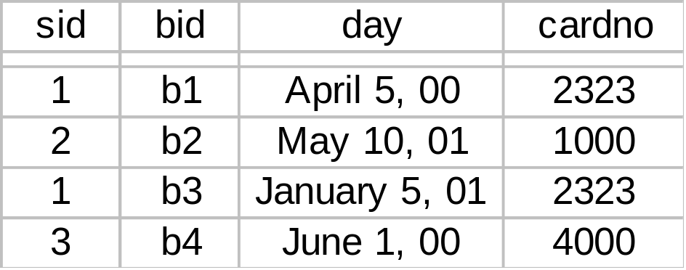
Reserves
Assume: sid → cardno (a sailor uses a unique credit card to pay for reservations).
Reserves is not in 3NF
  sid is not a key and cardno is not part of a key
  In fact, (sid, bid, day) is the only key.
  (sid, cardno) pairs are redundant.

Slide 43
Reserves
Assume: sid → cardno, and cardno → sid (we know that credit cards also uniquely identify the owner).
Reserves is in 3NF
  (cardno, bid, day) is also a key for Reserves.
  sid → cardno does not violate 3NF.

Slide 44
Decomposition
Decomposition is a tool that allows us to eliminate redundancy.
It is important to check that a decomposition does not introduce new problems.
  A decomposition allows us to recover the original relation?
  Can we check integrity constraints efficiently?

Slide 45
A set of relation schemas { R₁, R₂, …, R_{n} }, with n ≥ 2 is a
decomposition of R if
R₁ ∪ R₂ ∪ … ∪ R_{n} = R
Supply
sid
status
city
part_id
qty
Supplier
sid
status
city
and
SP
sid
part_id
qty

Slide 46
Supplier ∪ SP = Supply
  { Supplier, SP } is a decomposition of Supply
Decomposition may turn non-normal form into normal form.
Suppose R is not in BCNF, and X → A is a FD (where
X ∩ A = φ ) that violates the condition.
Remove A from R
Create a new relational schema XA
Repeat this process until all the relations are in BCNF

Slide 47
Problems with decomposition
Some queries become more expensive.
Given instances of the decomposed relations, we may not be able to reconstruct the corresponding instance of the original relation – information loss.
Checking some dependencies may require joining the instances of the decomposed relations.

Slide 48

Lossless Join Decomposition
The relation schemas { R₁, R₂, …, R_{n} } is a lossless-join decomposition of R if:
for all possible relation instances r on schema R,
r = Π_{R1}( r ) Π _{R2}( r ) … Π _{Rn}( r )

Slide 49
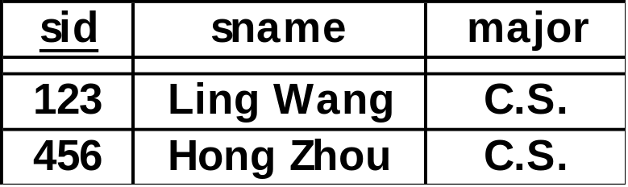
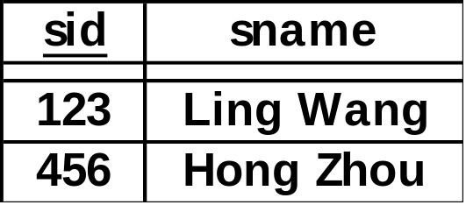
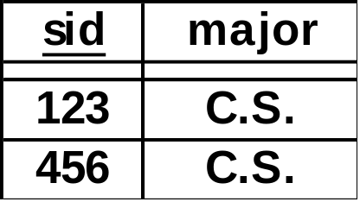
Example: a lossless join decomposition
IN
sid
sname
Student
sid
sname
major
IM
sid
major
Student
IN
‘Student’ can be recovered by joining the instances of IN and IM
IM

Slide 50
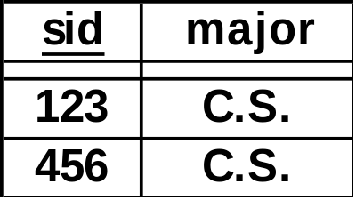
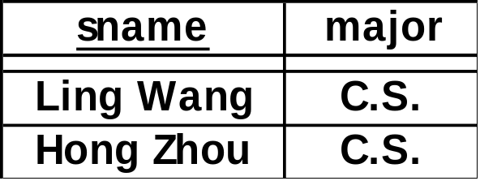
Example: a non-lossless join decomposition
IN
sid
major
Student
sid
sname
major
IM
sname
major
Student
IN
Student = IN IM????
IM

Slide 51
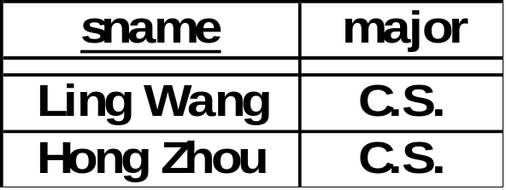
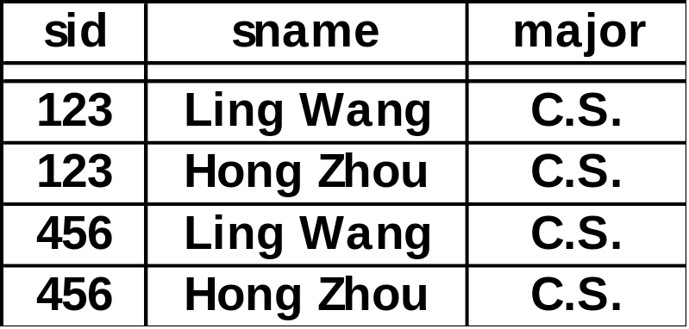

IN
IM
IN IM
Student
The instance of ‘Student’ cannot be recovered by joining the instances of IN and IM. Therefore, such a decomposition is not a lossless join decomposition.

Slide 52
Theorem:
R - a relation schema
F - set of functional dependencies on R
The decomposition of R into relations with attribute sets
R₁, R₂ is a lossless-join decomposition iff
( R₁ ∩ R₂ ) → R₁ ∈ F ⁺
OR
( R₁ ∩ R₂ ) → R₂ ∈ F ⁺
i.e., R₁ ∩ R₂ is a superkey for R₁ or R₂.
(the attributes common to R₁ and R₂ must contain a key for
either R₁ or R₂ ).

Slide 53
Example
  R = ( A, B, C )
  F = { A → B }
  R = { A, B } + { A, C } is a lossless join decomposition
  R = { A, B } + { B, C } is not a lossless join decomposition
Also, consider the previous relation ‘Student’
Please also read the example in P.620 of your textbook.

Slide 54
Another Example
R = { A, B, C, D }
F = { A → B, C → D }.
Decomposition: { (A, B), (C, D), (A, C) }
Consider it a two step decomposition:
Decompose R into R₁ = (A, B), R₂ = (A, C, D)
Decompose R₂ into R₃ = (C, D), R₄ = (A, C)
This is a lossless join decomposition.
If R is decomposed into (A, B), (C, D)
This is a lossy-join decomposition.

Slide 55
Dependency Preservation
R - a relation schema
F - set of functional dependencies on R
{ R₁, R₂ } – a decomposition of R.
F_{i} - the set of dependencies in F⁺ involves only attributes in R_{i}.
F_{i} is called the projection of F on the set of attributes of R_{i}.
dependency is preserved if
Intuitively, a dependency-preserving decomposition allows us to enforce all FDs by examining a single relation instance on each insertion or modification of a tuple.
( F₁ U F₂ )⁺ = F ⁺

Slide 56
Dependency set: F = { sid → dname, dname → dhead }
Student
sid
dname
dhead
IN
sid
dname
IH
sid
dhead

Slide 57
IN
sid
dname
IH
sid
dhead
F = { sid → dname, dname → dhead }
This decomposition does not preserve dependency:
F_{IN} = { trivial dependencies, sid → dname,
sid → sid dname}
F_{IH} = { trivial dependencies, sid → dhead,
sid → sid dhead }
We have: dname → dhead ∈ F ⁺ but
dname → dhead ∉ ( F_{IN} U F_{IH} )⁺

Slide 58
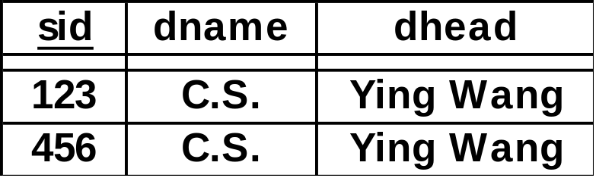
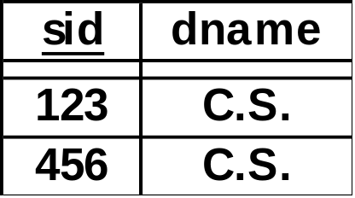
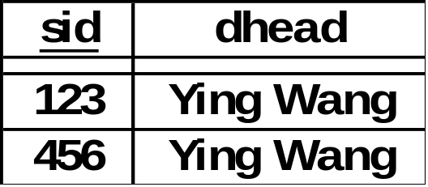
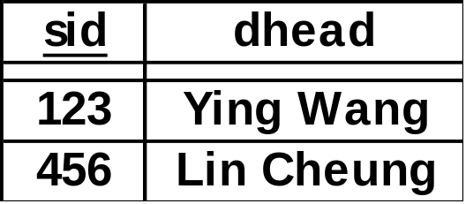
Student
IN
IH
and
Updated to
The update violates the FD ‘dname → dhead’. However, it can only be caught when we join IN and IH.

Slide 59
Dependency set: F = { sid → dname, dname → dhead }
Let’s decompose the relation in another way.
Student
sid
dname
dhead
IN
sid
dname
NH
dname
dhead

Slide 60
IN
sid
dname
NH
dname
dhead
F = { sid → dname, dname → dhead }
This decomposition preserves dependency:
F_{IN} = { trivial dependencies, sid → dname,
sid → sid dname}
F_{NH} = { trivial dependencies, dname → dhead,
dname → dname dhead }
( F_{IN} U F_{NH} )⁺ = F ⁺

Slide 61
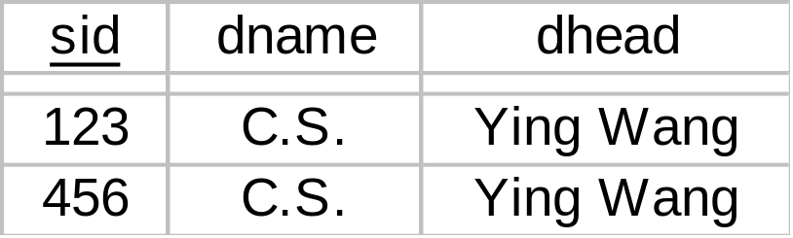
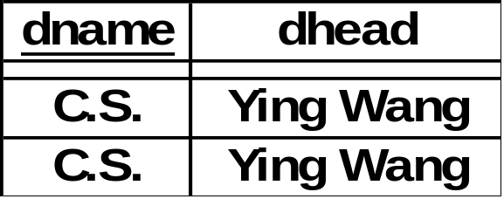
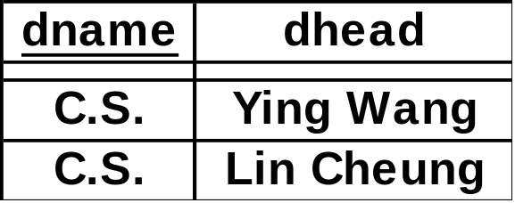
Student
IN
NH
and
Updated to
The error in NH will immediately be caught by the DBMS,
since it violates F.D. dname → dhead. No join is necessary.

Slide 62
Normalization
Consider algorithms for converting relations to BCNF or 3NF.
If a relation schema is not in BCNF
  it is possible to obtain a lossless-join decomposition into a collection of BCNF relation schemas.
  Dependency-preserving is not guaranteed.
3NF
  There is always a dependency-preserving, lossless-join decomposition into a collection of 3NF relation schemas.

Slide 63
BCNF Decomposition
Suppose R is not in BCNF, A is an attribute, and X → A is a FD that violates the BCNF condition.
Decompose R into XA and R-A
Repeat this process until all the relations become BCNF
It is a lossless join decomposition.
But not necessary dependency preserving

Slide 64
Key is C
CSJDPQV
SD→P
J→S
SD→P
SDP
CSJDQV
J→S
JS
CJDQV

Slide 65
Key is C
SD→P
CSJDPQV
J→S
SD→P
JP →C
SDP
CSJDQV
J→S
JS
CJDQV
The result is in BCNF
Does not preserve JP→C, we can add a schema:
CJP
Each of SDP, JS, CJDQV, CJP is in BCNF, but there is
redundancy in CJP (Not recommended).

Slide 66
Possible refinement
CSJDPQV
Key is C
SD→P
SD→P
SDP
CSJDQV
SD→Q
SD→Q
SDQ
CSJDV
SD is a key in SDP and SDQ,
There is no dependency between P and Q
we can combine SDP and SDQ into one schema
Resulting in SDPQ, CSJDV

Slide 67
Example
R = ( J, K, L )
F = ( JK → L, L → K )
Two candidate keys JK and JL.
R is not in BCNF
Any decomposition of R will fail to preserve JK → L.
However, it is possible for 3NF decomposition to be both
lossless join and dependency preserving.
To see how, we need to know something else first.

Slide 68
Canonical Cover
A minimal and equivalent set of functional dependency
Two sets of functional dependencies E and F are equivalent
if E⁺ = F⁺
Example: R = ( A, B, C )
F = { A → BC, B → C, A → B, AB → C }
F can be simplified : By the decomposition rule,
A → BC implies A → B and A → C
Therefore A → B is redundant.
F’= { A → BC, B → C, AB → C }

Slide 69
Example: R = ( A, B, C )
F = { A → BC, B → C, A → B, AB → C }
Another way to show A → B is redundant:
From A → BC, B → C, AB → C ,
Compute the closure of A:
result = A
result = ABC, Hence A⁺ = ABC
Therefore A → B is redundant.
F’= { A → BC, B → C, AB → C }

Slide 70
Example (cont)
F’ can be further simplified
F’ = { A → BC, B → C, AB → C }
B → C (given)
AB → AC ( augmentation )
AB → C ( decomposition )
AB → C is redundant,
or A is extraneous in AB → C.
F”= { A → BC, B → C }

Slide 71
Example (cont.)
F’ = { A → BC, B → C, AB → C }
Another way to show that A is extraneous in AB → C
  F” = { A → BC, B → C}
  we can compute (AB)⁺ under F” as follows
  result = AB
  result = ABC ( B → C )
  Hence (AB)⁺ = ABC
AB → C is redundant,
or A is extraneous in AB → C.
F”= { A → BC, B → C }

Slide 72
Example (cont.)
F”= { A → BC, B → C }
C is extraneous in A → BC :
From A → B and B → C
we can deduce A → C ( transitivity ).
From A → B and A → C
we get A → BC ( union )
F”’ = { A → B, B → C } …….. This is a canonical cover for F

Slide 73
Example (cont.)
F”= { A → BC, B → C }
Another way to show C is extraneous in A → BC :
  F’” = { A → B, B → C}
  we can compute A⁺ under F’” as follows
  result = A
  result = AB ( A → B )
  result = ABC ( B → C )
  Hence A⁺ = ABC
  A → BC can be deduced
F”’ = { A → B, B → C } …….. This is a canonical cover for F

Slide 74



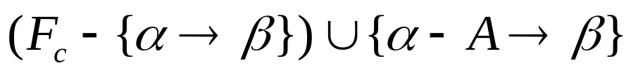
A canonical cover F_{c} of a set of functional dependency F must have the following properties.
  Every functional dependency in F_{c} contains no extraneous attributes in (ones that can be removed from without changing F_{c}⁺). So A is extraneous in if and
  logically implies F_{c}.

Slide 75


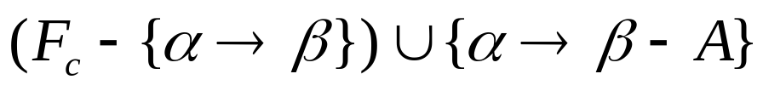



  Every functional dependency in F_{c} contains no extraneous attributes in (ones that can be removed from without changing F_{c}⁺). So A is extraneous in if and
  logically implies F_{c}.
  Each left side of a functional dependency in F_{c} is unique. That is there are no two dependencies and in F_{c} such that .

Slide 76
Compute a canonical cover for F :
repeat
Replace any α₁ → β₁ and α₁ → β₂
by α₁ → β₁ β₂
Delete any extraneous attribute
from any α → β
until F does not change

Slide 77
Example: Given F = { A → BC, A → B, B → AC, C → A }
Combine A → BC, A → B into A → BC
F’ = { A → BC, B → AC, C → A }
F” = { A → B, B → AC, C → A }
C is extraneous in A → BC because
  we can compute A⁺ under F” as follows
  result = A
  result = AB ( A → B )
  result = ABC ( B → AC )
  Hence A⁺ = ABC
  And we can deduce A → BC,

Slide 78
Example (cont):
F” = { A → B, B → AC, C → A }
F’” = { A → B, B → C, C → A }
A is extraneous in B → AC because
  we can compute B⁺ under F”’ as follows
  result = B
  result = BC ( B → C )
  result = ABC ( C → A )
  Hence B⁺ = ABC
  And we can deduce B → AC,
F’” = { A → B, B → C, C → A } …… Canonical cover for F

Slide 79
3NF Synthesis Algorithm
  Find a canonical cover F_{c} for F ;
  result = φ;
  for each α → β in F_{c} do
  if no schema in result contains αβ
  then add schema αβ to result;
  if no schema in result contains a candidate key for R
  then begin
  choose any candidate key α for R;
  add schema α to the result
  end
Note: result is lossless-join and dependency preserving

Slide 80
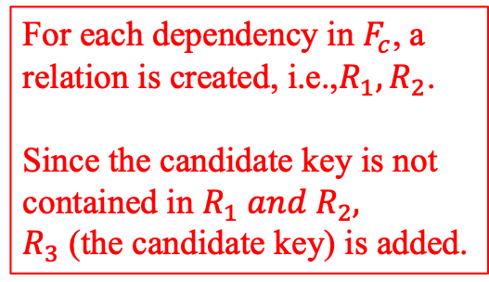
Example
R = ( student_id, student_name, course_id, course_name )
F = { student_id → student_name,
course_id → course_name }
{ student_id, course_id } is a candidate key.
F_{c} = F
R₁ = ( student_id, student_name )
R₂ = ( course_id, course_name )
R₃ = ( student_id, course_id)

Slide 81
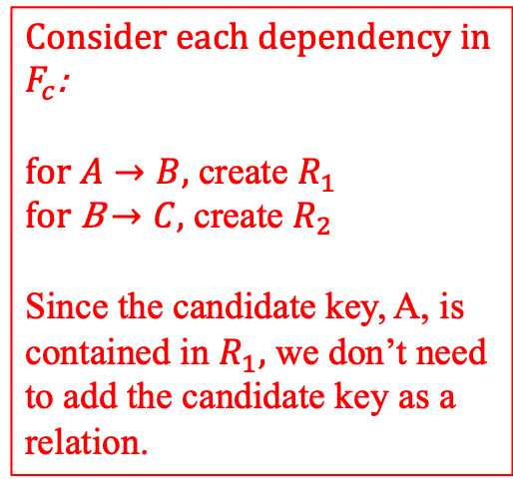
Example 2
R = ( A, B, C )
F = { A → BC, B → C }
R is not in 3NF
F_{c} = { A → B, B → C }
Decomposition into: R1 = ( A, B ), R2 = ( B, C )
R1 and R2 are in 3NF

Slide 82
BCNF VS 3NF
always possible to decompose a relation into relations in 3NF and
  the decomposition is lossless
  dependencies are preserved
always possible to decompose a relation into relations in BCNF and
  the decomposition is lossless
  may not be possible to preserve dependencies

Slide 83
More Examples
Candidate keys are (sid, part_id)
and (sname, part_id).
{ sid, part_id } → qty
{ sname, part_id } → qty
sid → sname
sname → sid
The relation is in 3NF:
For sid → sname, … sname is in a candidate key.
For sname → sid, … sid is in a candidate key.
However, this leads to redundancy (Not BCNF)
sname
part_id
sid
qty
SSP

Slide 84
sname
part_id
sid
qty
SSP
If we decompose the schema into
R₁ = ( sid, sname ), R₂ = ( sid, part_id, qty )
These are in BCNF.
The decomposition is dependency preserving.
{ sname, part_id } → qty can be deduced from
  sname → sid (given)
  { sname, part_id } → { sid, part_id } (augmentation on (1))
  { sid, part_id } → qty (given)
and finally transitivity on (2) and (3).

Slide 85
More Examples
part_id
city
sid
At a city, for a certain part, the supplier is unique:
city part_id → sid.
Also, sid → city
SUPPLY
SUPPLY
city
part_id
sid
The relation is not in BCNF:
sid → city is not trivial, and … sid is not a superkey
It is in 3NF:
sid → city … city is in the candidate key of { city, part_id }.
If we decompose into ( sid, city ) and ( sid, part_id ) we have BCNF, however
{ city, part_id } → sid will not be preserved.

Slide 86
Design Goals
Goal for a relational database design is:
  BCNF
  lossless join
  Dependency preservation
If we cannot achieve this, we accept:
  3NF
  lossless join
  Dependency preservation

